Slide 1
Available Parking Spaces Counter
CSE 4128
Image Processing and Computer Vision
Course Teachers:
Dr. SK. Md. Masudul Ahsan
Professor
Department of CSE
KUET
Presented By:
Irhamul Islam Roll:1907093
Department of CSE
KUET
Dipannita Biswas
Lecturer
Department of CSE
KUET

Slide 2
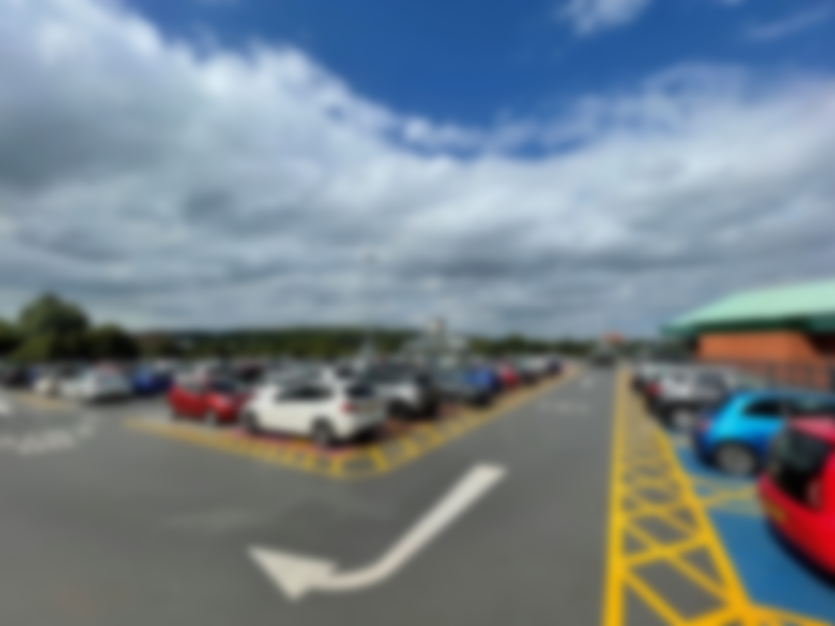
Available Parking Spaces Counter
CSE 4128
Image Processing and Computer Vision
Course Teachers:
Dr. SK. Md. Masudul Ahsan
Professor
Department of CSE
KUET
Presented By:
Irhamul Islam Roll:1907093
Department of CSE
KUET
Dipannita Biswas
Lecturer
Department of CSE
KUET

Slide 3

Available Parking Spaces Counter
CSE 4128
Image Processing and Computer Vision
Course Teachers:
Dr. SK. Md. Masudul Ahsan
Professor
Department of CSE
KUET
Presented By:
Irhamul Islam Roll:1907093
Department of CSE
KUET
Dipannita Biswas
Lecturer
Department of CSE
KUET

Slide 4
Outlines
Introduction
Methodology
UI Mockup
Output of Internal Steps
Final Result
Future Improvments
Conclusions
2

Slide 5
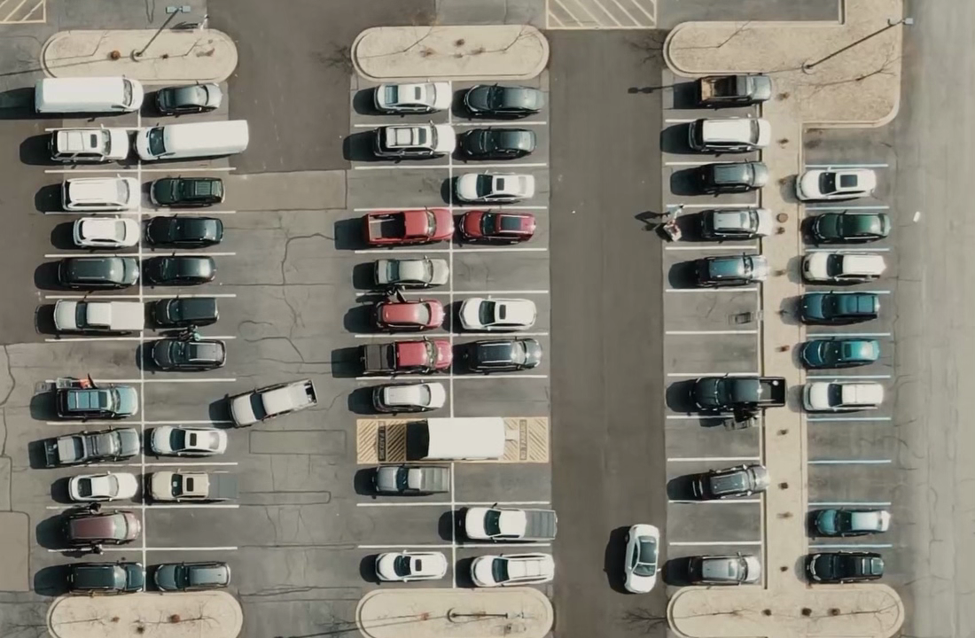
Introduction
Our project addresses the pressing need for automated parking management through advanced image processing.
Goal is to optimize parking slot detection to improve urban mobility and efficiency.
Using image processing techniques, aiming to streamline urban infrastructure and enhance user experience.
3

Slide 6
Methodology
Select parking slots
Apply Gaussian Blur
Apply thresholding
Apply Median Filter
Apply Dilation
Check available space by intensity count
4

Slide 7
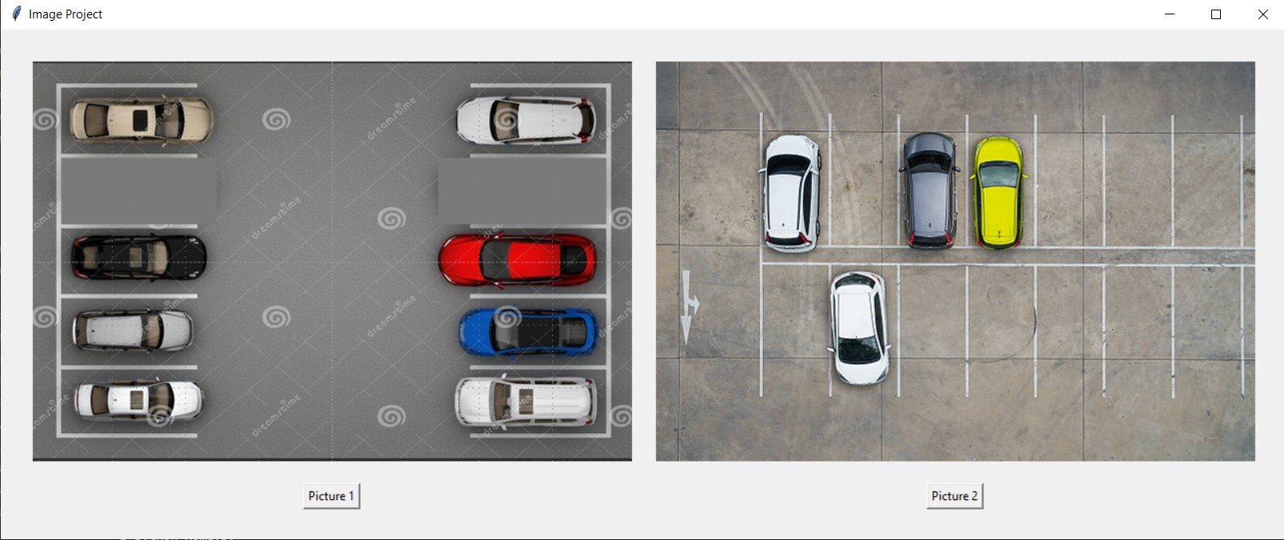
Home Ui
Figure : Homepage
5

Slide 8
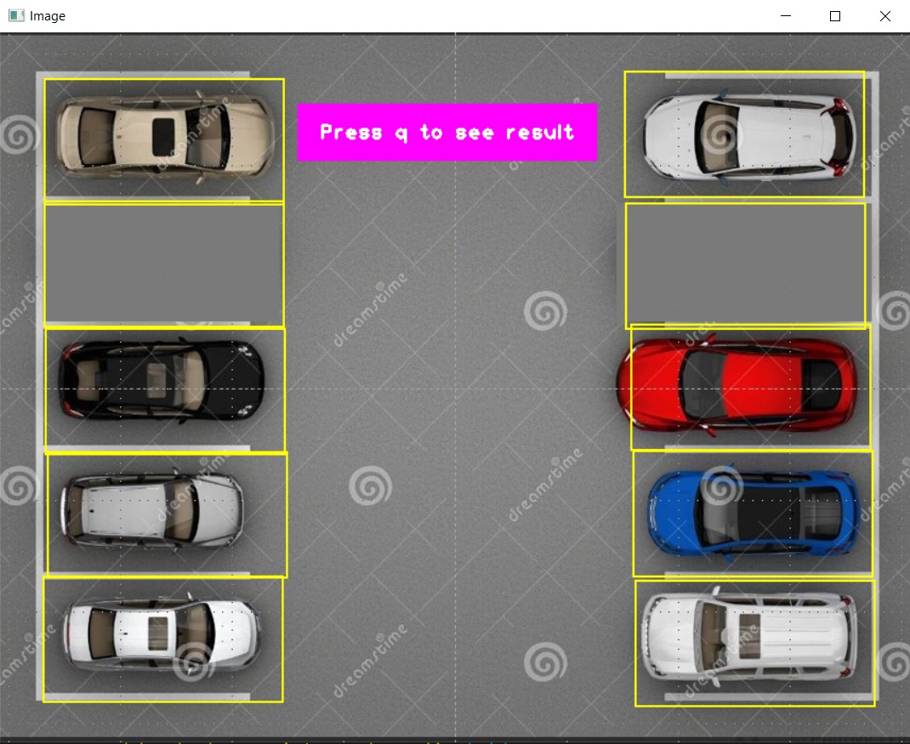
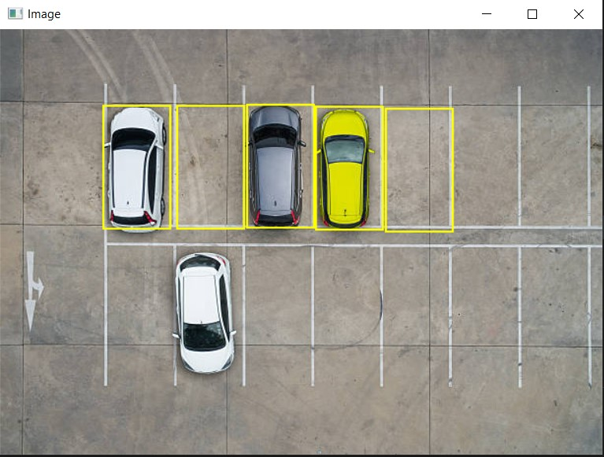
Ui-SpacePicker
Figure : Page to select parking slots-Set 1
Figure : Page to select parking slots-Set 2
6

Slide 9
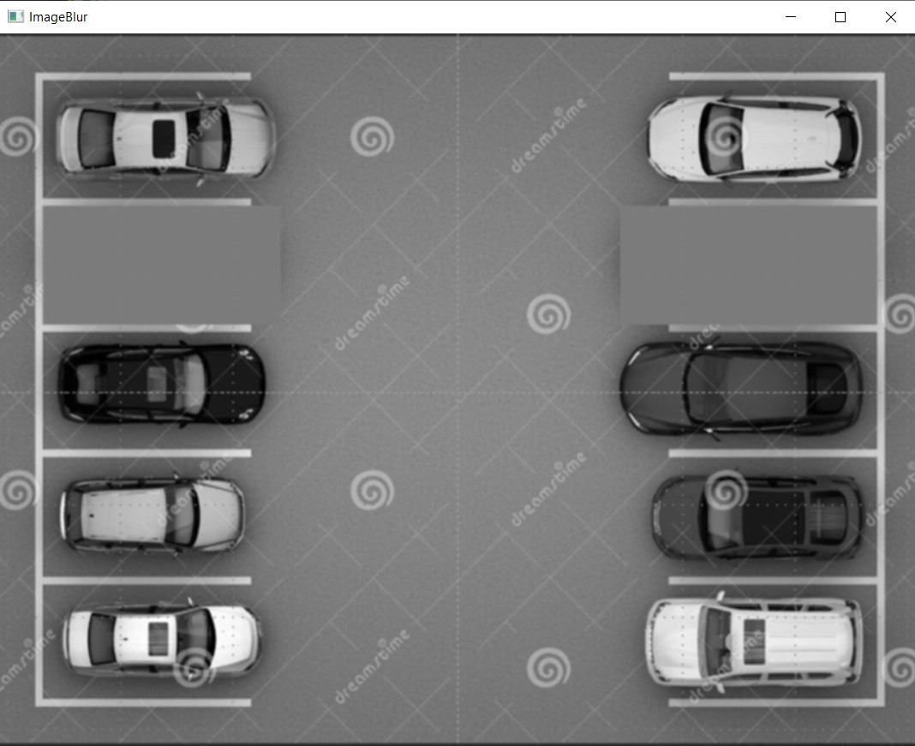
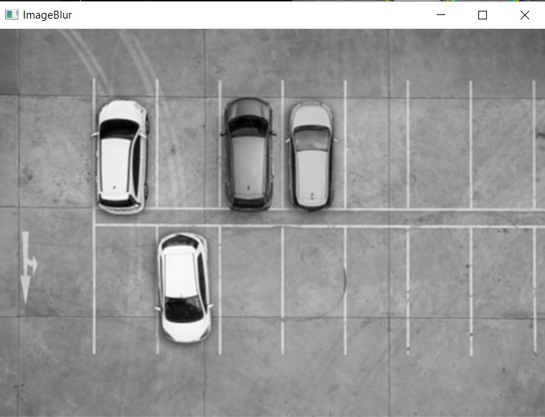
Output of internal steps
Apply Gaussian Blur
Figure : Gaussian Blur applied-Set 1
Figure : Gaussian Blur applied-Set 2
7

Slide 10
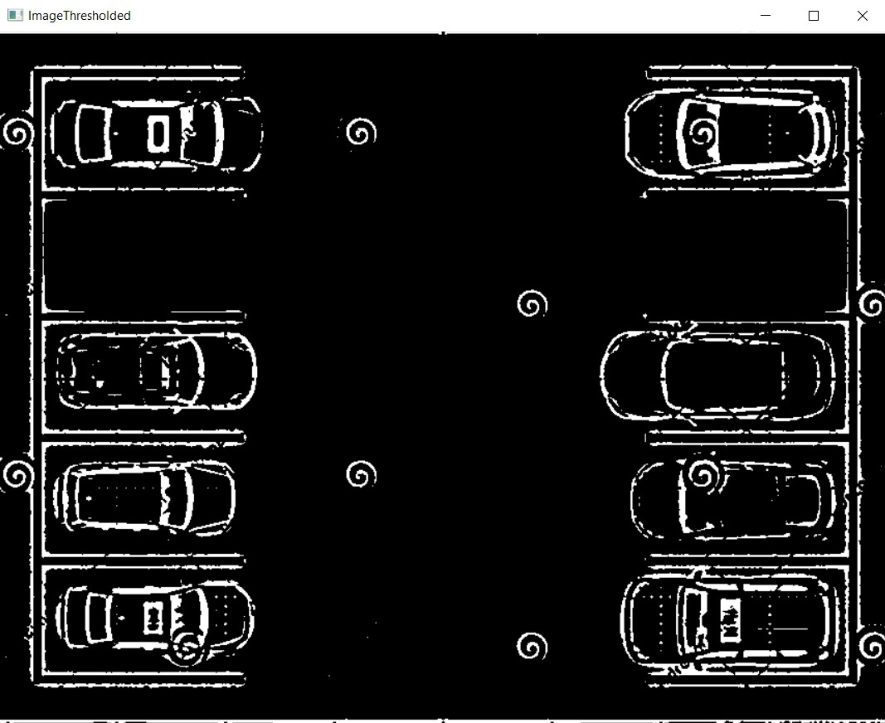
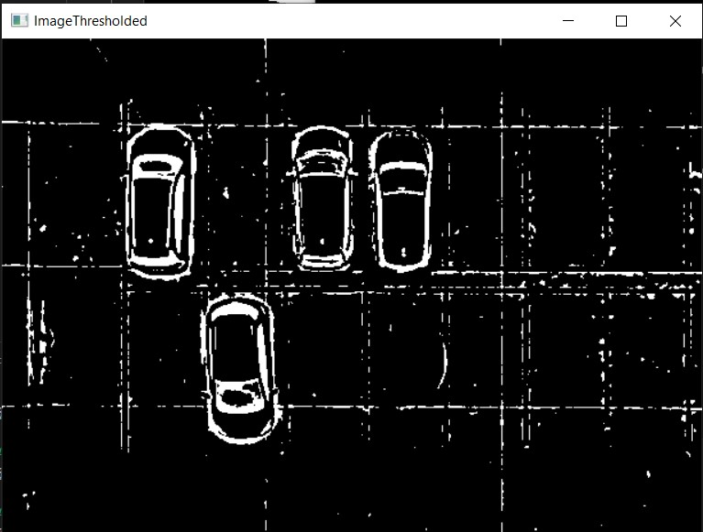
Output of internal steps
Apply thresholding
Figure : Thresholding applied-Set 1
Figure : Thresholding applied-Set 2
8

Slide 11
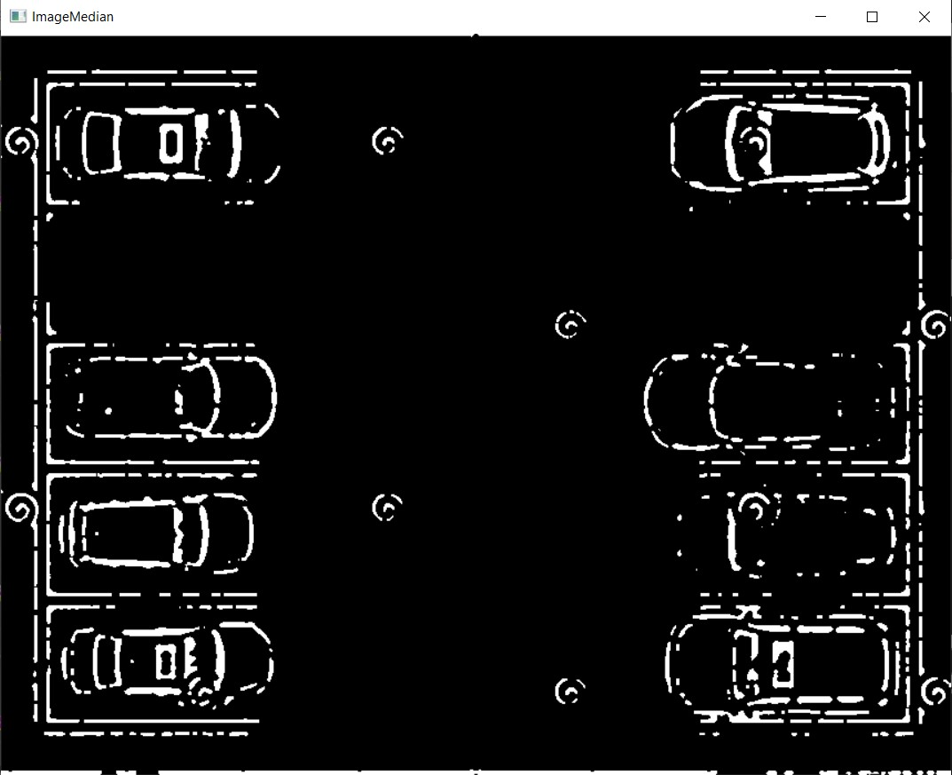
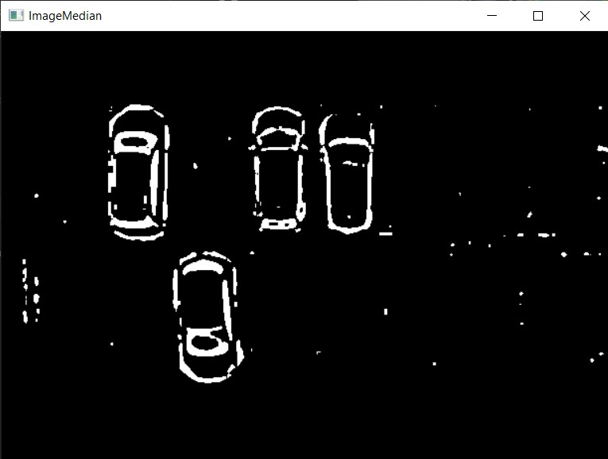
Output of internal steps
Apply Median Filter
Figure : Noise reduced –Set 1
Figure : Noise reduced –Set 2
9

Slide 12
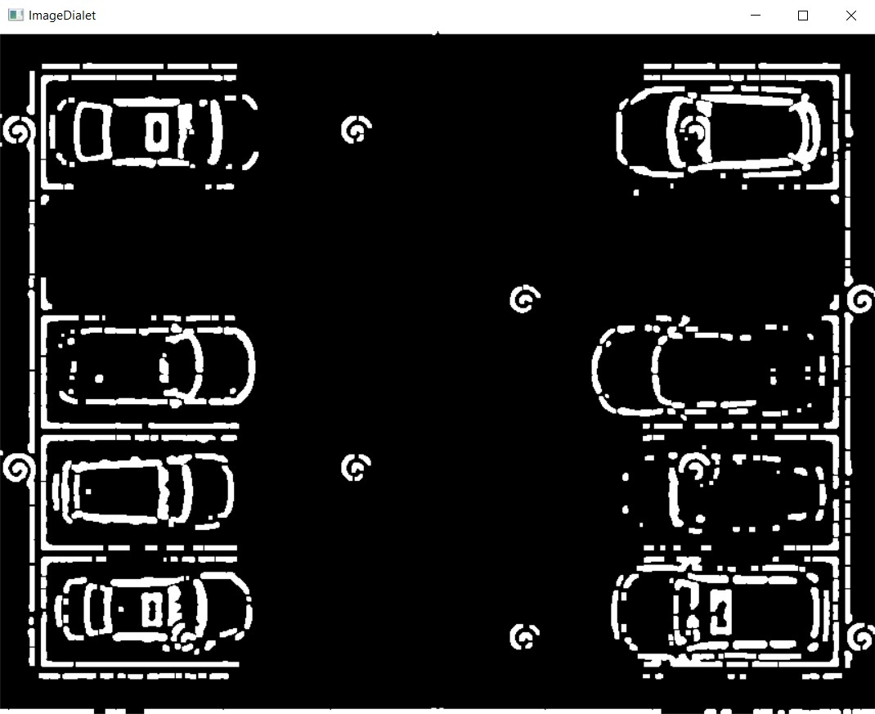
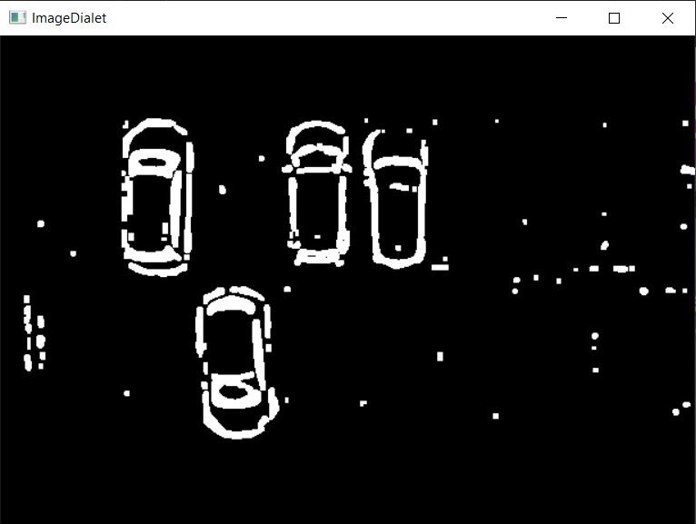
Output of internal steps
Apply Dilation
Figure : Dilation applied–Set 1
Figure : Dilation applied–Set 2
10

Slide 13
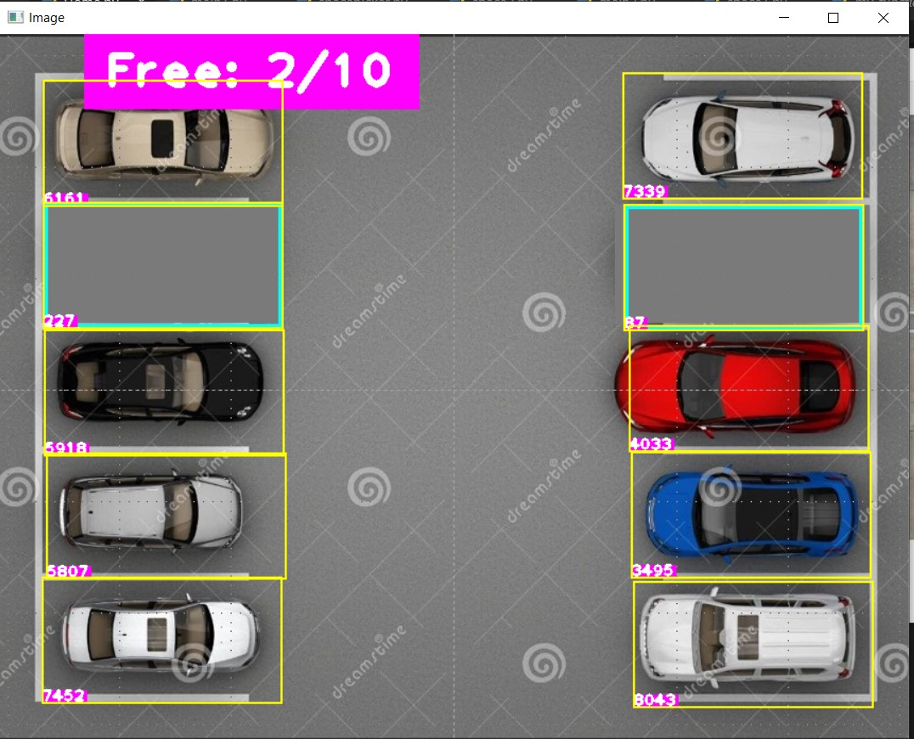
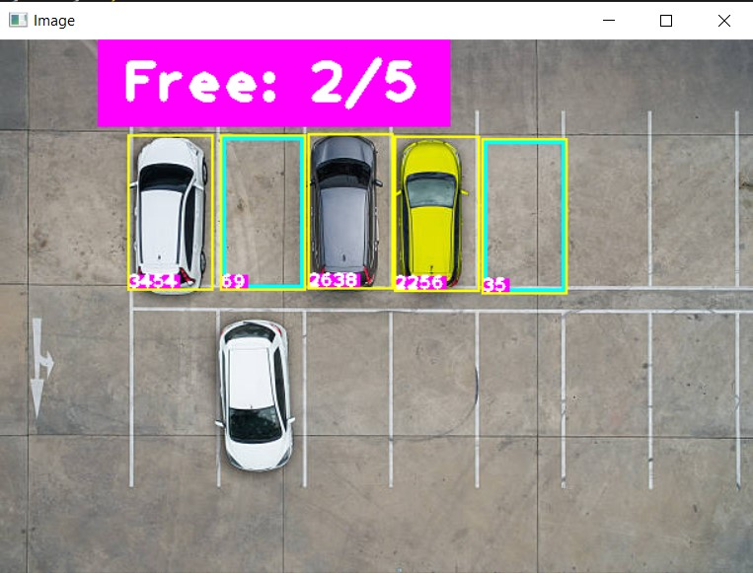
Final Result
Check available space by intensity count
Figure : Final count-Set 1
Figure : Final count-Set 2
11

Slide 14
Future Improvements
Automated Parking Slot Selection
Automated Thresholding Adjustment:
User Interface Enhancements
Generalization for Multiple Images:
Performance Optimization:
Feedback and Iterative Development
12

Slide 15
Conclusion
Demonstrated effective use of image processing techniques for automated parking slot detection.
Highlighted potential for further automation and enhancement through machine learning and advanced algorithms.
Emphasized the impact on urban infrastructure efficiency and user experience.
Identified opportunities for future research and development in smart city technologies.
13

Slide 16
Thank you..

